Slide 1
OBJECT ORIENTED PROGRAMMING PROJECT
TOPIC: INTRACITY BUS MANANGEMENT SYSTEM
SUBMITTED TO:
DR. SARABJEET SINGH
SUBMITTED BY:
AISHITA CO21305
HARKIRAN CO21320

Slide 2
INTRODUCTION
PROJECT NAME: INTRACITY BUS MANAGEMENT SYSTEM
LANGUAGE USED: C++ PROGRAMMING LANGUAGE
OBJECTIVE:
To create a system which perform all the operations required during the process of reservation along with a system which manages the administrative work involved.

Slide 3
CONCEPTS USED
CLASSES
LOOPS
SWITCH CASE
OBJECTS
FUNCTION
STRINGS

Slide 4
FUNCTIONS USED:
MAJOR FUNCTIONS USED:
admin()
allotment()
empty()
show()
avail()
position()

Slide 5
Admin()
By using this function specific values are allotted to a bus such as bus no., driver’s name, departure time, arrival time by taking input from the user.
Each time a new bus is added , the total number of available buses is increased by one (this is achieved by incrementing the value of p in the source code).

Slide 6
Allotment()
This function is used to allocate seats to passengers during the time of reservation.
A user is asked to enter number of seats required and in case the seats are vacant they can be reserved for the user else an error is printed on the screen.

Slide 7
Empty()
This function is used to initialise all the seats as empty . This implies these seats are vacant and can be reserved by the user.
By providing basic details such as no. of seats required and seat no. , desired seats can be reserved.

Slide 8
Show()
This function is used to print/show all the details related to a particular bus.
The user is asked to enter the bus no. and if it matches with the list of existing buses the details are shown else an error showing incorrect bus number is shown.

Slide 9
Position()
This function is used to print/show the current status of the seats.
In case the seat is vacant “empty” is printed and if the seat is already reserved passenger details are provided in place of empty.

Slide 10
Avail()
This function is used to show each and every detail regarding all the existing buses.
Under this function user can access / see all the buses which are available for services.

Slide 11
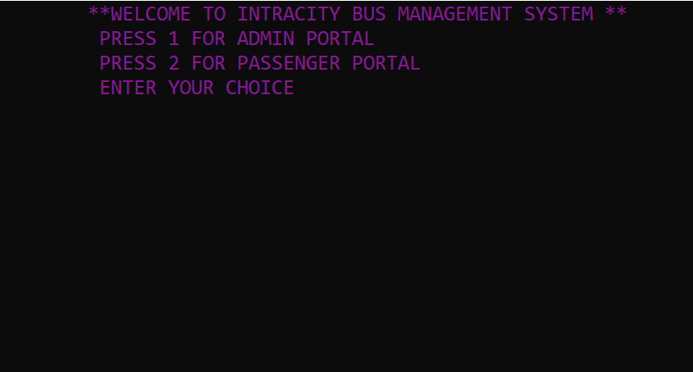
MAIN SCREEN
Two options are provided to the user as per their role
Admin portal – for the users who are related to bus management authority
Passenger portal – for the user who wants/wishes to reserve seats in a bus

Slide 12
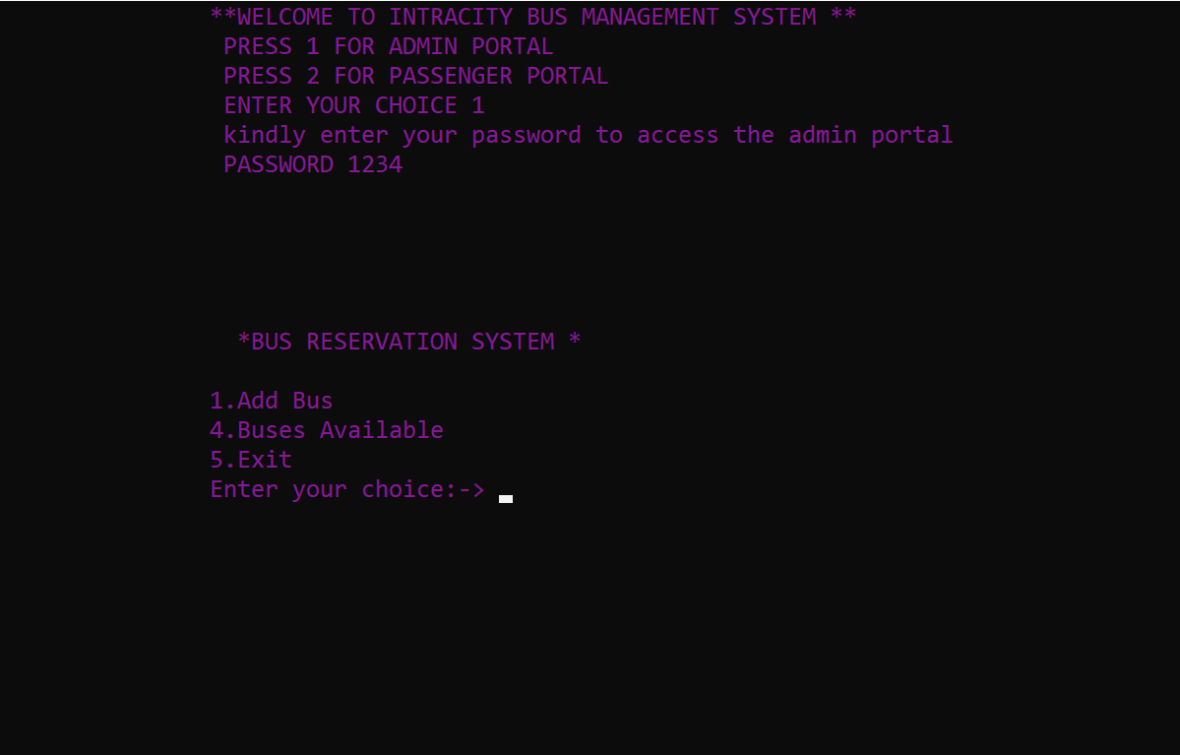
ADMIN PORTAL
In order to access this portal user needs to enter a correct (pre set) password.
In case the entered password does not match with the inbuilt password an error will appear and the process will stop.
The portal offers the following choices:
Add bus option
Available buses option

Slide 13
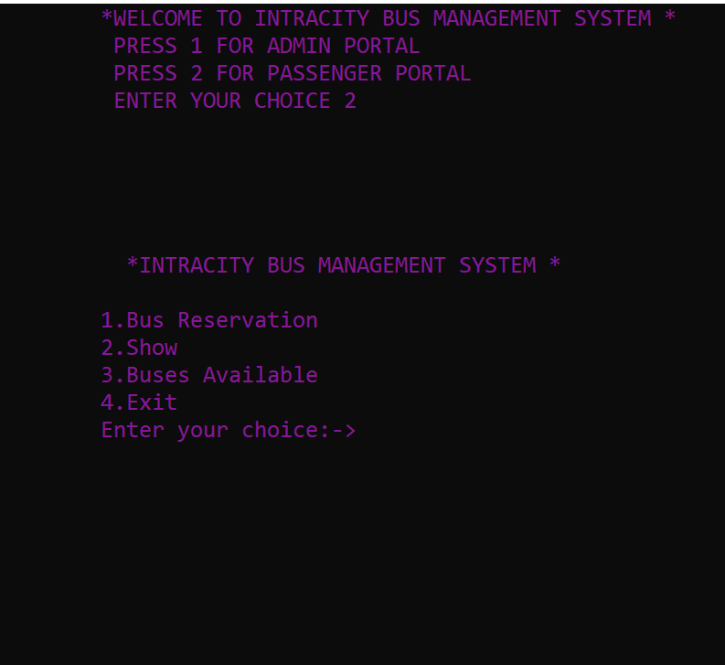
PASSENGER PORTAL
This portal offers the following options:
Buses available
Bus reservation
Show

Slide 14
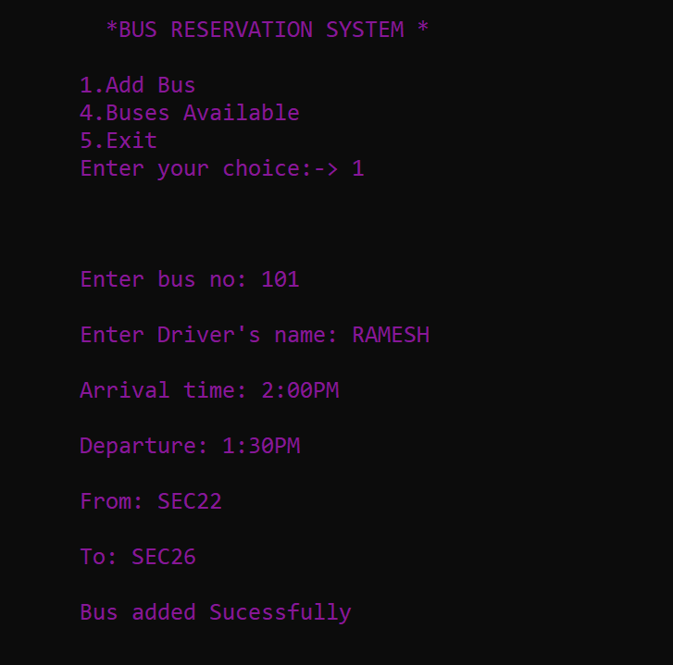
ADD BUS OPTION
This option gives an access to the admin to add a new buses in the list of pre existing buses.
Following details are to be provided by the admin in order to add a new bus:
BUS NO.
DRIVER’S NAME
ARRIVAL TIME
DEPARTURE TIME
STARTING POINT
DESTINATION

Slide 15
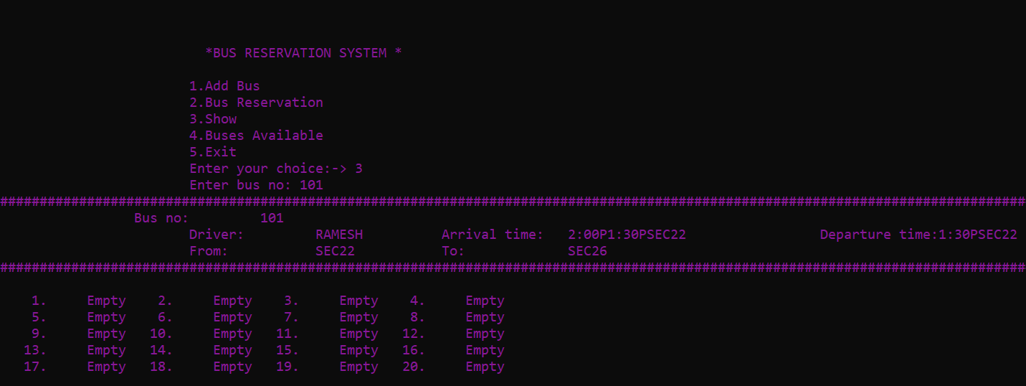
BUSES AVAILABLE OPTION
This option once selected provides details of all the buses which are available for services.

Slide 16
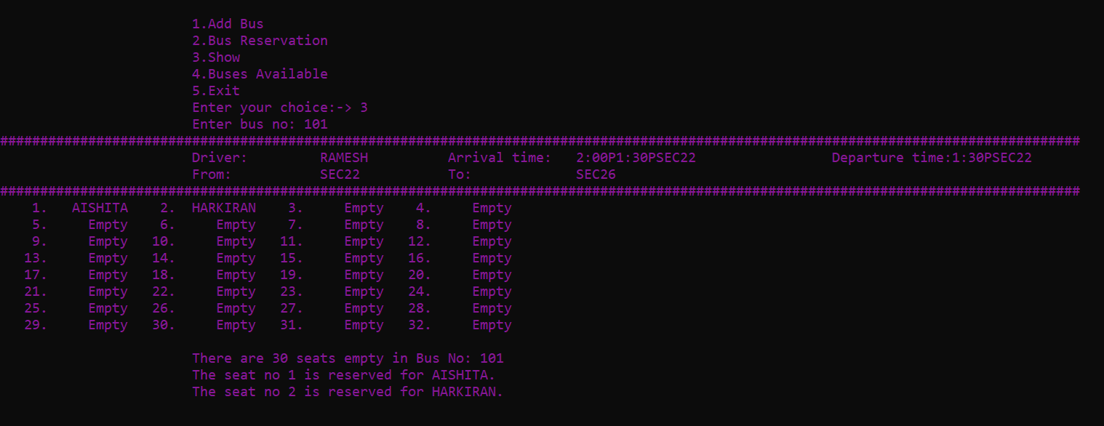
SHOW OPTION
This option once selected shows all the details regarding the selected bus like bus no, time of departure etc along with the status of seats
In case the seats are vacant passenger can book respective seats as per their preference.

Slide 17
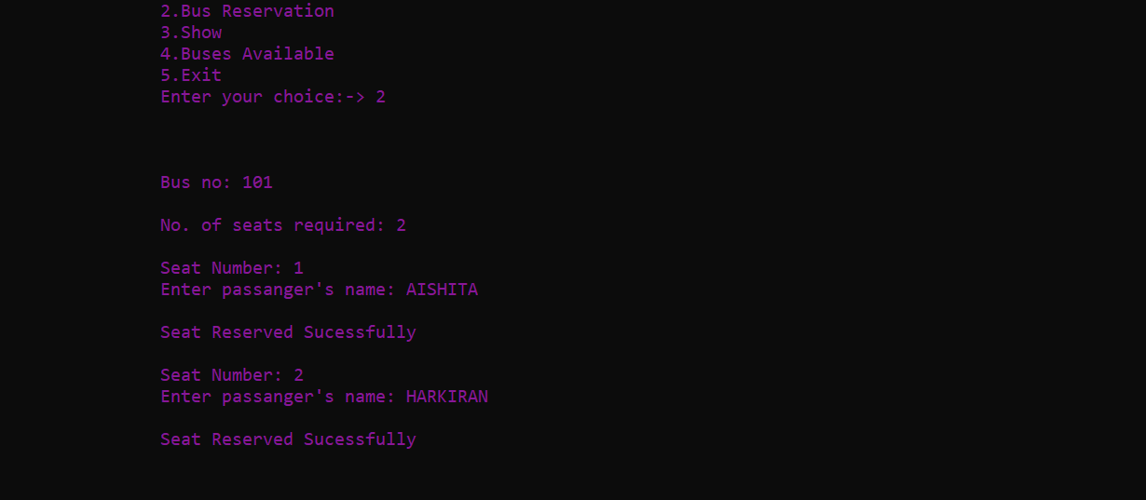
BUS RESERVATION OPTION
This option is exclusively available for the passengers.
By choosing this option user can reserve seats in their desired bus by providing basic details such as:
Bus number
Number of seats required
Name of the passengers

Slide 18
THANK YOU

